Slide 1
32 bit ALU With Integrated RAM

Slide 2
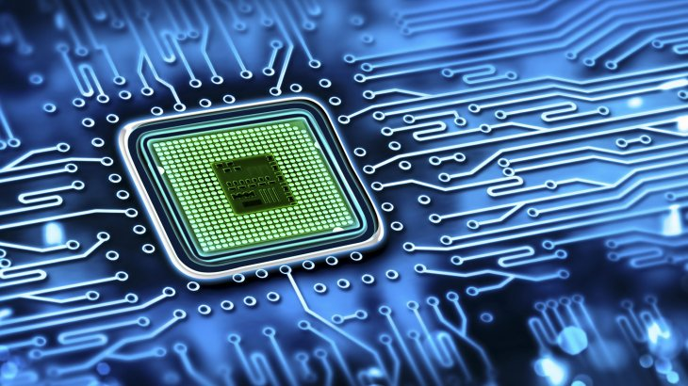
Introduction to ALU
Introduction to RAM
32-bit ALU
Working of 32-bit ALU
Design Code
Testbench
Applications
Advantages/Disadvantages
Summary

Slide 3
Introduction To ALU
ALU stands for Arithmetic Logic Unit. It is a fundamental component of the CPU.
Performs arithmetic operations like addition and subtraction.
Executes logic operations like AND, OR, XOR, and NOT. Operates on binary input data (usually two operands).
Controlled by an opcode (operation code) to select the function. Outputs a result and may produce status flags (zero, carryout, overflow).
Plays a crucial role in data processing and decision-making.
Can be integrated with memory (RAM) for data storage and retrieval.
Used in all digital systems—from simple microcontrollers to complex CPUs.

Slide 4
Random Access Memory [RAM]:
Integrated RAM provides temporary storage for operands and results within the ALU system.
It is typically a small memory array (e.g., 256 x 32-bit) with read/write capabilities.
ALU reads input data from RAM, performs operations, and writes the result back.
Controlled using signals like address, write_enable, data_in, and data_out.Mimics how a real processor interacts with memory for instruction and data processing.
Enables efficient data flow, testing, and operation sequencing in ALU-based designs.

Slide 5
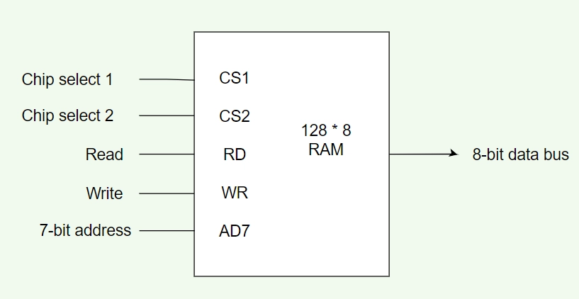
Block Diagram Of RAM
Inputs:
Chip select1
Chip select2
Read
Write
7-bit address
Output:
8-bit data bus

Slide 6
Introduction To 32-Bit ALU
A 32-bit ALU performs arithmetic and logic operations on 32-bit binary data.
It supports functions like addition, subtraction, AND, OR, XOR, and NOT.
Operates based on an opcode, which selects the desired operation.Takes two 32-bit inputs and produces a 32-bit result along with status flags (e.g., zero, carryout).
Commonly used in processors and digital systems to perform high-speed computations.
Serves as the core of data processing in CPUs, microcontrollers, and embedded systems.

Slide 7
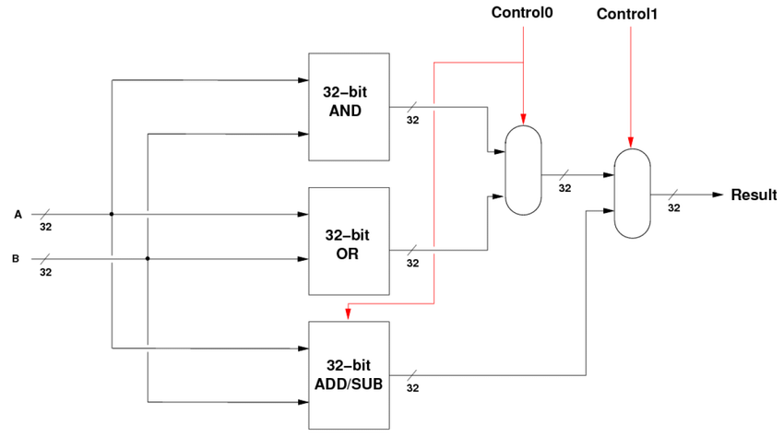
Block Diagram of 32-bit ALU:

Slide 8
Working Of 32-Bit ALU:
The RAM stores 32-bit binary operands and can be accessed using address lines.
The ALU receives two 32-bit operands from RAM based on read addresses.
An opcode input determines which operation the ALU will perform (e.g., ADD, SUB, AND).
The ALU processes the operands and generates a 32-bit result.
Status flags like zero and carryout are updated based on the operation result.
The result from the ALU can be written back into RAM at a specified address.

Slide 9
7. The RAM uses control signals such as write_enable, read_address, and write_address.
8. This allows read-modify-write operations, enabling data to flow smoothly between RAM and ALU.
9. The design simulates a simple processor data path, combining computation and storage.
10. This setup is commonly used in CPU design simulations and digital system testbenches.

Slide 10
Integration Of ALU and RAM:
ALU and RAM are connected to allow data exchange and processing.
Operands are read from RAM and fed into the ALU.
ALU performs operations based on an opcode.
The result is written back to RAM if needed.
Control signals manage read/write and operation flow.
Enables a simple CPU-like behavior for efficient computation.
Efficient data storage and access.
Enhanced processing speed.

Slide 11
Design Code:
Purpose: Performs arithmetic and logical operations on two 32-bit operands (A and B) based on a control opcode.
Inputs:A[31:0], B[31:0] – 32-bit operands.opcode[3:0] – selects the ALU operation (e.g., add, sub, and, or, xor, slt).
Outputs:Result[31:0] – output of the operation.Zero – high if result is 0.
CarryOut – high if there's a carry out (for arithmetic).
Structure:Case statement on opcode to select operation.
Flag logic to set Zero and CarryOut appropriately.

Slide 12
Top Module Code
Purpose: Integrates ALU with RAM for read/write of operands and storing results.
Components:ALU Block – performs the computation.RAM Block – holds data operands and stores output.Inputs:clk, reset, opcode, addr_a, addr_b, addr_result.
Control Logic:Reads A and B from RAM at addr_a, addr_b.Passes them to ALU with opcode.Stores ALU_Result in RAM at addr_result.
Outputs: done, Zero, CarryOut, optional output bus for verification.

Slide 13
Testbench Code
Test Bench for 32-bit ALU + RAMPurpose: Stimulates the top module to verify ALU and RAM interaction.
Initial Setup:Declare reg inputs and wire outputs.Instantiate top module (DUT).
Clock Generation:Use an always #5 clk = ~clk; block.Stimulus Logic:Use initial block to:Apply reset.
Write operands to RAM.Set opcode, addresses.Trigger computation.
Monitor Results:Use $display or $monitor to show ALU result and flags.Compare expected vs actual output.

Slide 14
Practical Applications:
Used in embedded systems and microcontrollers.
Helps in teaching computer architecture concepts.
Useful for FPGA-based processor prototyping.
Applied in Digital Signal Processing (DSP) tasks.
Suitable for simulation and testing of logic operations.
Can be part of custom ASIC designs in VLSI projects.

Slide 15
Advantages:
Performs multiple arithmetic and logic operations efficiently
Integrated RAM allows direct data access and storage
Modular design – easy to expand or modify
Useful for learning and simulation in tools like Vivado
Demonstrates real-world processor functionality
Promotes understanding of hardware-software interaction

Slide 16
Summary
This presentation explored the design and implementation of a 32-bit ALU (Arithmetic Logic Unit) integrated with RAM, using Verilog. We covered the fundamental concepts of ALUs and RAM, detailed their block diagrams, and explained their individual workings. The core of the presentation focused on the architectural overview and Verilog code for the ALU, RAM, and their top-level integration, along with the test bench explanation. Finally, we discussed the practical applications of such systems in embedded devices and education, highlighting their advantages like modularity and efficient operations, while also acknowledging current limitations such as basic operation support and lack of advanced features like pipelining.

Slide 17


